Slide 1
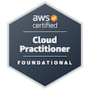
AWS CLI Setup and Testing: Demonstrating My Cloud Management Skills
MOHD UMAIR MEHDI
AWS Certified Cloud Practitioner

Slide 2
Introduction This documentation details the process followed to set up and configure the AWS Command Line Interface (CLI) for managing AWS services. It demonstrates the steps I took to configure the AWS CLI, execute commands, and verify functionality, showcasing my proficiency in cloud management.
Prerequisites
The setup involved:
An active AWS account
AWS CLI installed
IAM user credentials with appropriate permissions
Basic knowledge of key AWS services (e.g., EC2, S3, Lambda)

Slide 3
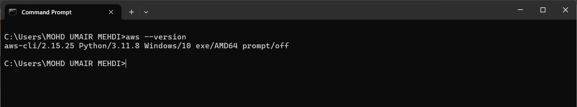
Step 1: Installing AWS CLI Windows The AWS CLI installer was downloaded from the AWS CLI WEBSITE, and the installation steps were followed.
Verifying Installation
To confirm successful installation, the AWS CLI version was checked using: aws --version
By getting this output, I have Successfully Installed AWS CLI

Slide 4
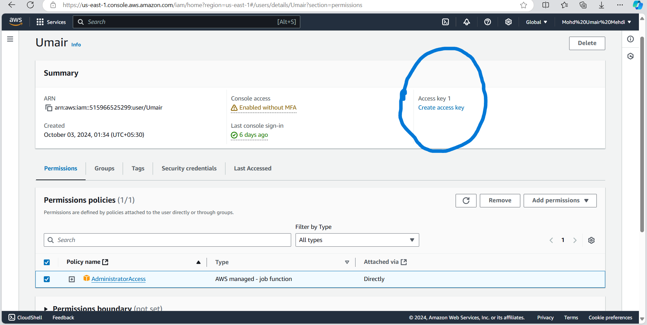
Step 2: Configuring AWS CLI
Creating IAM User Credentials
In this step, I logged into the AWS Management Console, navigated to IAM (Identity and Access Management), and created an IAM user with the required permissions (e.g., AdministratorAccess, AmazonS3FullAccess). The Access Key ID and Secret Access Key were stored for later use.
IAM User Dashbord (pic-1)
Create Access Key From Here
I have grant “AdministratorAccess” to the user

Slide 5
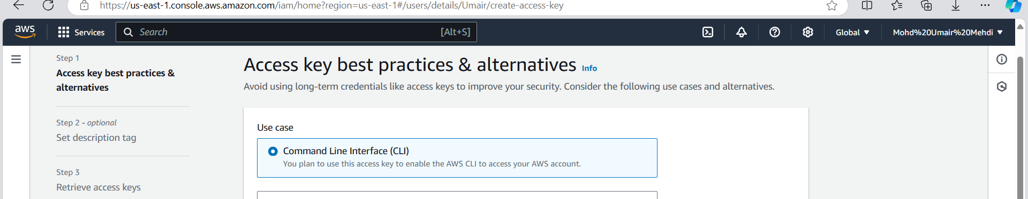
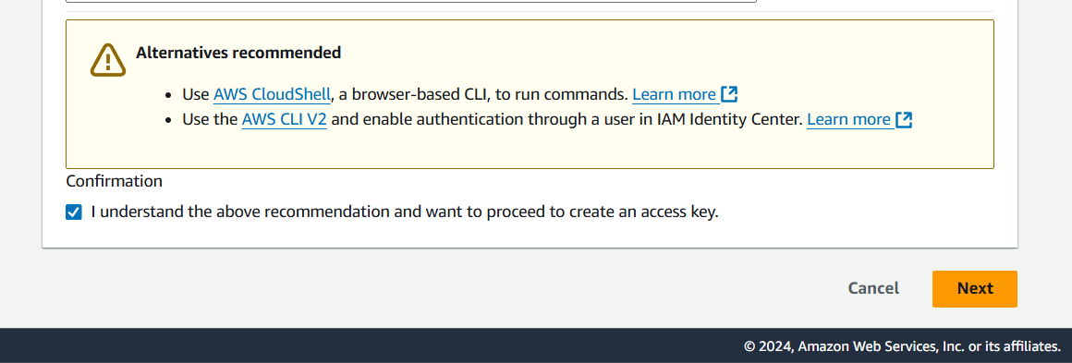
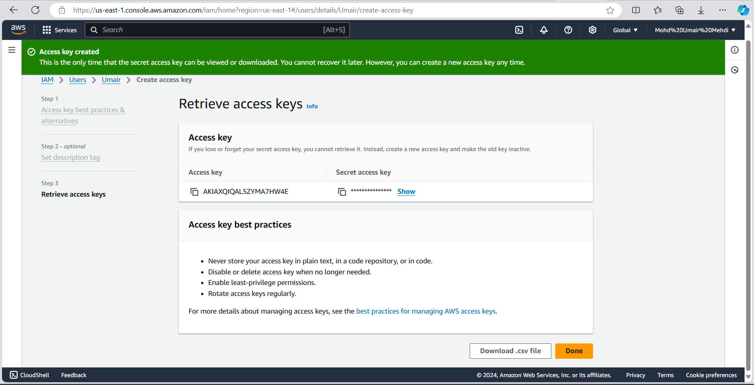
Select the CLI option (pic-2)
Do Confirm And Click On Next (pic-3)
Successfully Created Access Key (pic-4)

Slide 6
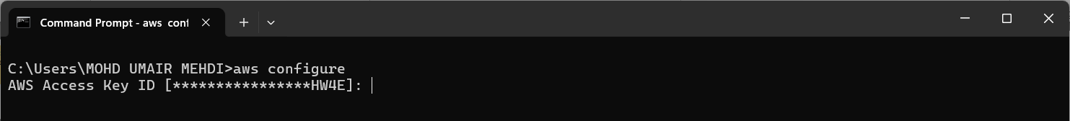
3. Configuring AWS CLI
Once the IAM user & Access Key is generated, configure it using your IAM credentials:
Command: aws configure
You will be prompted to input the following:
AWS Access Key ID: Input your access key ID.
AWS Secret Access Key: Input your secret access key.
Default region name: Specify a region (e.g., us-east-1).
Default output format: Set this to json, text, or table (recommend json).
Get these two from pic-4
These two are optional

Slide 7
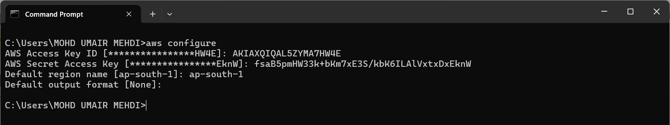
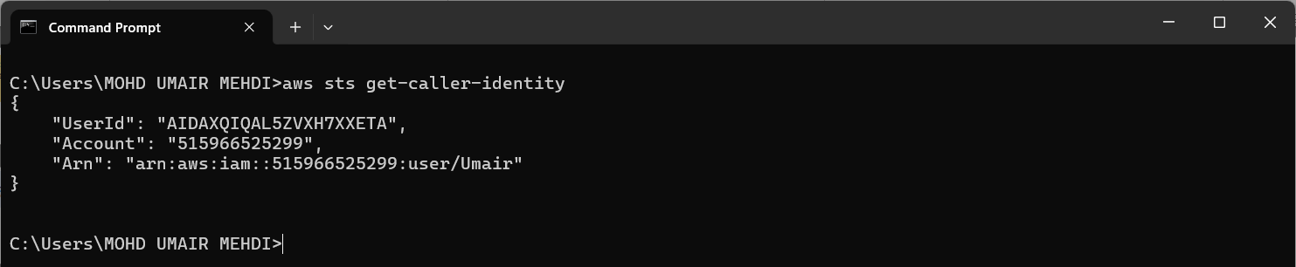
Like this
Verify Configuration: Check that the configuration is correct by running:
Command: aws sts get-caller-identity
We got “UserId, Account & Arn” Successfully

Slide 8
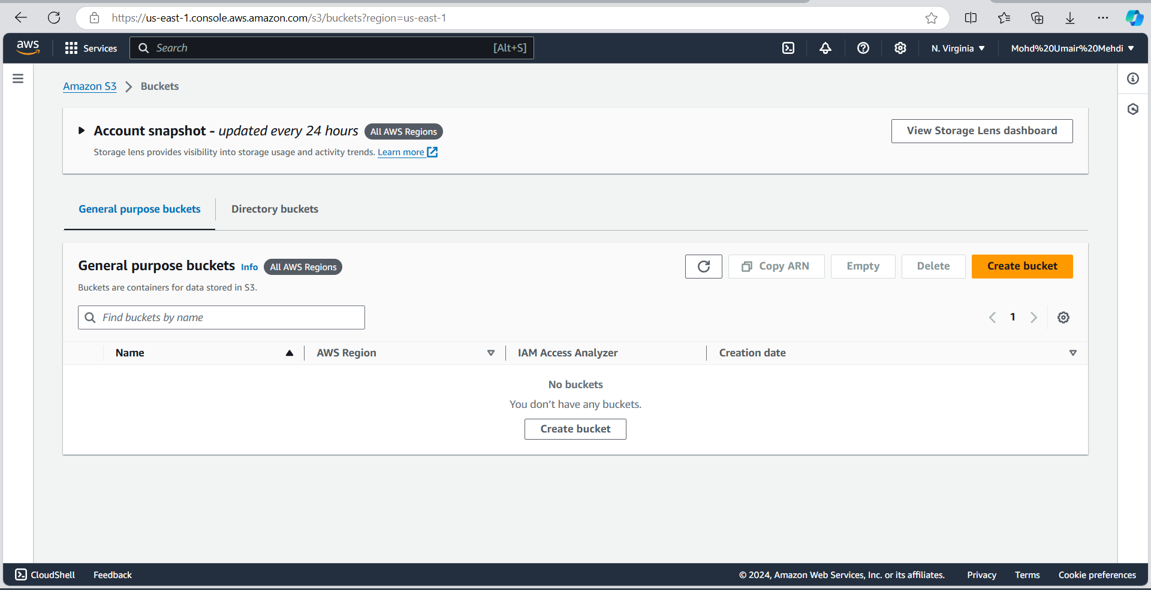
Upon checking S3 bucket dashboard, I found there are no active buckets.
Step 3: Create an S3 Bucket (Testing CLI Commands)
Create a bucket:
run the command (aws s3 mb s3://my-cli-demo13 --region ap-south-1)
Bucket Nme
Specify the region

Slide 9
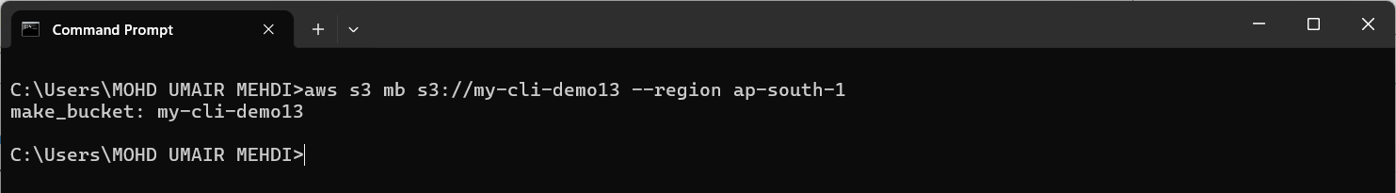
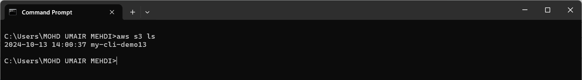
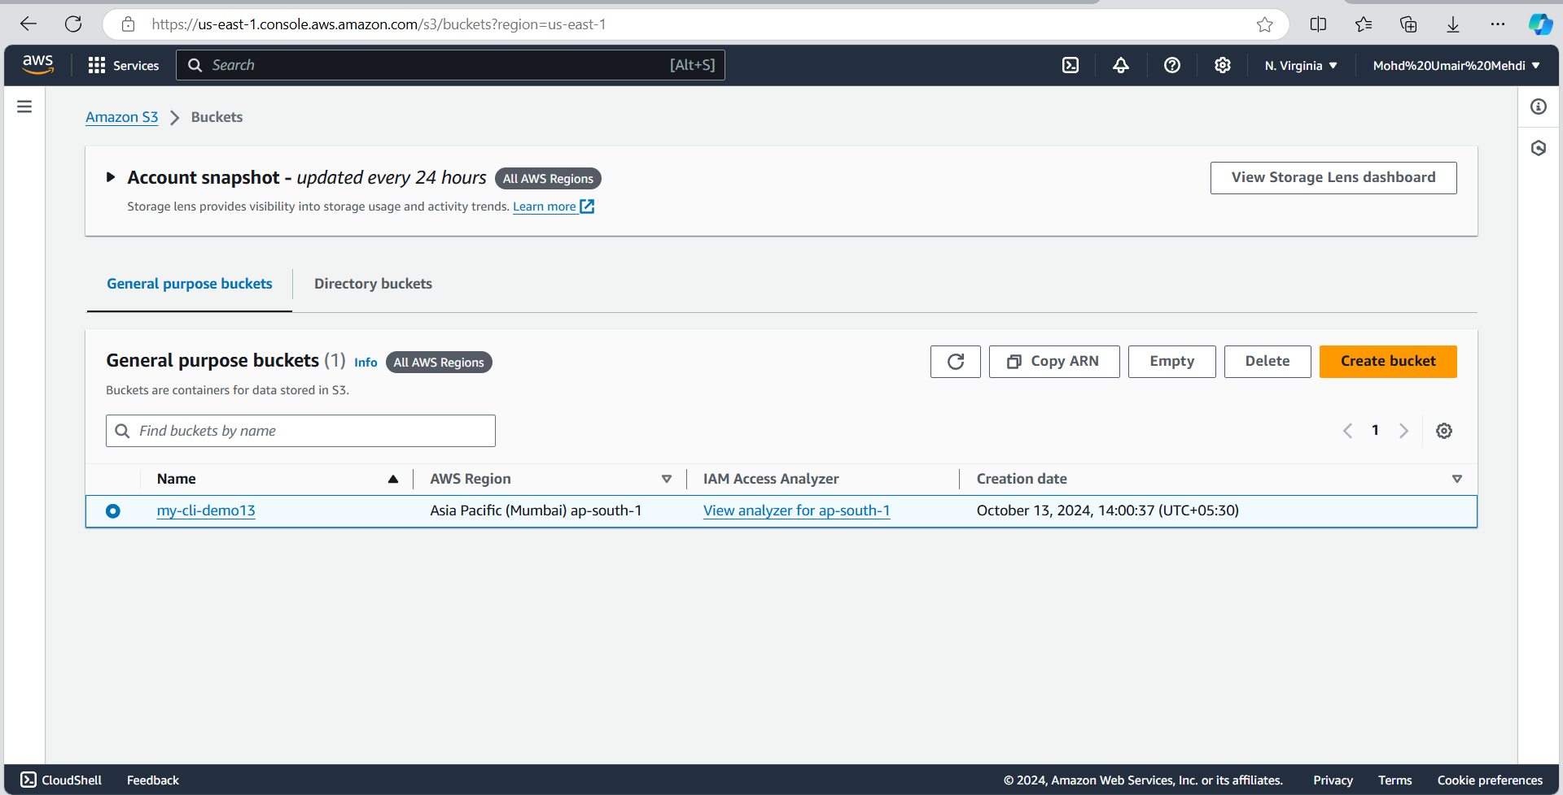
The bucket has been created successfully
Verify bucket creation:
By ls (list) command
(aws s3 ls)
Verifying through the AWS Management Console

Slide 10
Step 4: Upload a File to S3 Bucket
Upload a file to the bucket
Command (aws s3 cp your-file.txt s3://your-bucket-name/)
When uploading a file with the cp command, the file is being transferred from your local machine to an S3 bucket.
Bucket Name
Copy path of the file and paste it (if there is space in your file name the use “” for the entire path

Slide 11
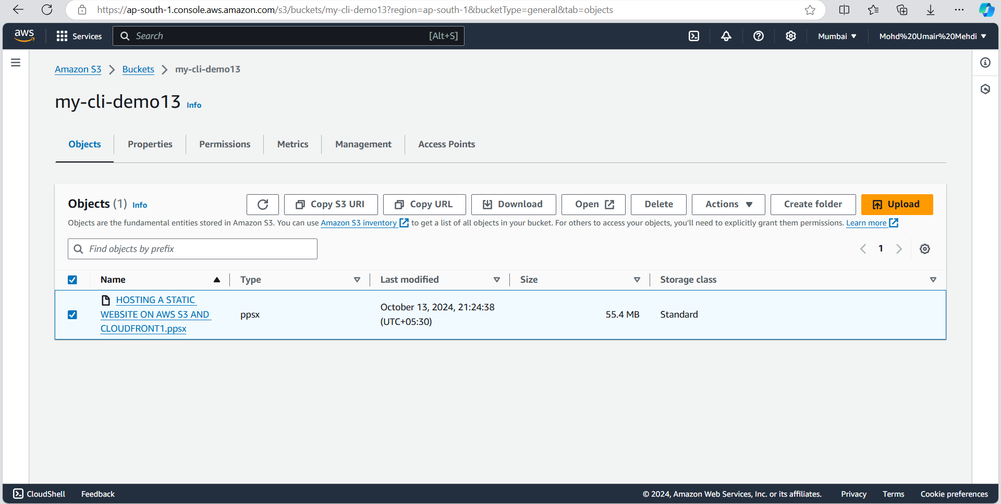
Verify file upload:
Command (aws s3 ls s3://my-cli-demo13/)
Verifying through the AWS Management Console

Slide 12
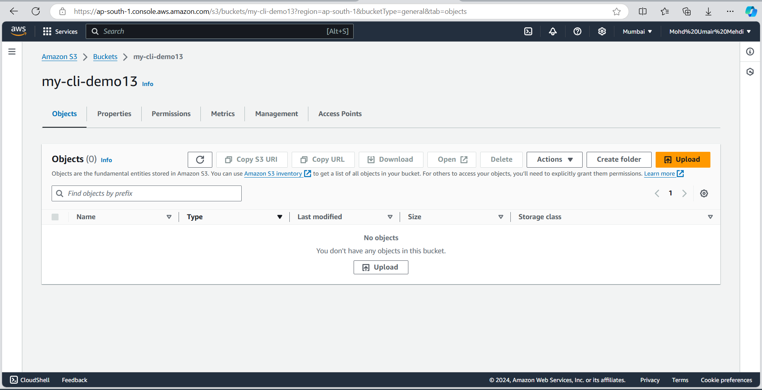
Now DELETING the FILE which I have just uploaded
Just replace the ‘cp’ with ‘rm’ to delete the FILE in bucket
The FILE has been deleted successfully
Verifying through the AWS Management Console

Slide 13
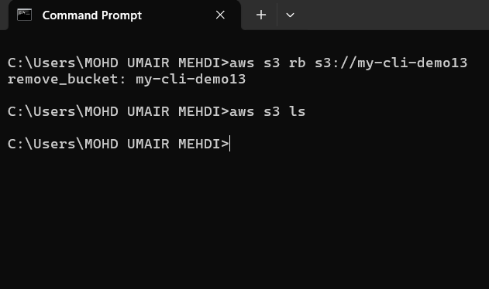
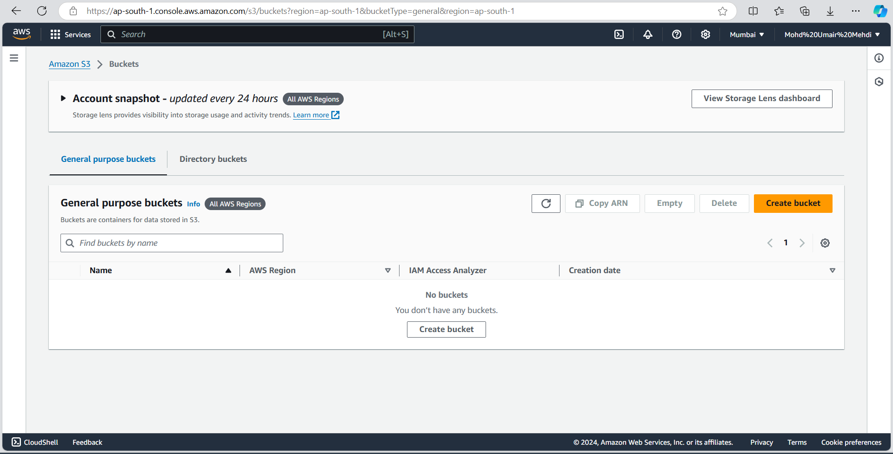
Now DELETING the BUCKET
Just replace the ‘rm’ with ‘rb’ to delete BUCKET
The BUCKET has been deleted successfully
Verifying from the CLI
Verifying from the AWS Management Console

Slide 14
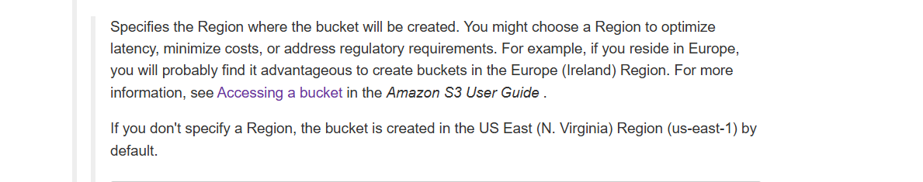
Lessons Learned:
S3 Bucket Default Region: One thing I learned during this project was that if you don’t specify a region when creating an S3 bucket, AWS assigns it to a default region—usually us-east-1. This wasn’t something I had considered at first, but it made me realize how important it is to choose the right region, especially for things like performance and cost optimization. Going forward, I’ll make sure to explicitly set the region using the
--region flag to avoid any surprises and to make sure the resources are set up exactly where I need them.
Reference of this Screenshort

Slide 15
References:
AWS CLI Installation:
AWS CLI Installation Guide (Windows, macOS, Linux)
AWS S3 CLI Documentation:
AWS S3 CLI Command Reference
Commands Used in the Project:
Create S3 Bucket:
List Objects in S3 Bucket:
aws s3 ls s3://your-bucket-name/
Reference: AWS S3 CLI: ls (List Buckets/Objects)
Delete File from S3 Bucket:
aws s3 mb s3://your-bucket-name --region us-east-1
aws s3 rm s3://your-bucket-name/your-file.txt
Reference: AWS S3 CLI: mb (Make Bucket)
Reference: AWS S3 CLI: rm (Remove Files)
List S3 Buckets:
Delete S3 Bucket:
aws s3 ls
aws s3 rb s3://your-bucket-name
Reference: AWS S3 CLI: ls (List Buckets/Objects)
Reference: AWS S3 CLI: rb (Remove Bucket)
Upload File to S3 Bucket:
aws s3 cp your-file.txt s3://your-bucket-name/
Reference: AWS S3 CLI: cp (Copy Files)

Slide 16
Conclusion:
Through this project, I’ve gained solid experience in using the AWS CLI to manage cloud resources efficiently. I now have a strong understanding of key tasks like creating S3 buckets, managing files, and configuring region-specific settings. Working with the AWS CLI has shown me how powerful and time-saving it can be for automating tasks. I’m confident that these skills will be incredibly useful in future projects, and I look forward to applying what I’ve learned to make the most of AWS services.
MOHD UMAIR MEHDI
AWS Certified Cloud Practitioner

